Slide 1
Nick’s Kitchen
An online recipe database
Group 26
Nicholas Skinner

Slide 2
Problem Statement
Recipe databases often display the recipes, ingredients, and the steps for cooking, but an estimation of the price is often left out, leaving people with no idea of how much a recipe could potentially cost.

Slide 3
Functionality
Users can sign up for accounts, with passwords and emails
Users can login, and logout
List of top recipes can be displayed on the home page with clickable links.
Users can comment on the recipe.
Users can search recipes, users, ingredients, and costs.
Users can add or update ingredients.
Notes:
Use multiple points, if necessary.

Slide 4
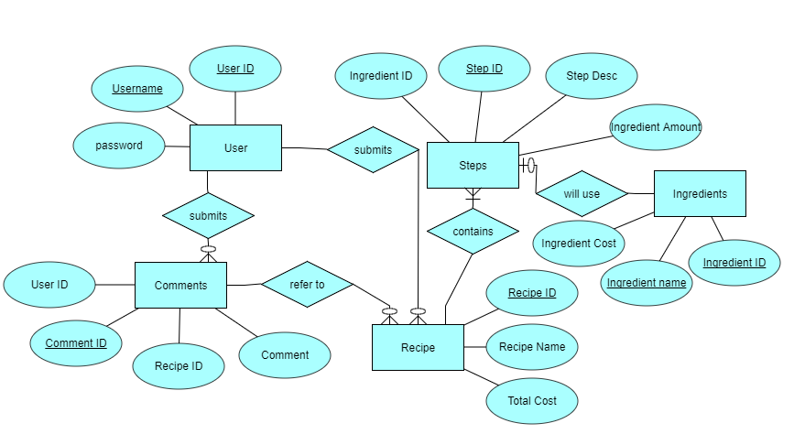
ERD

Slide 5
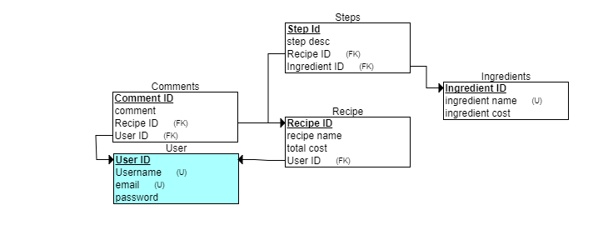
ERS

Slide 6
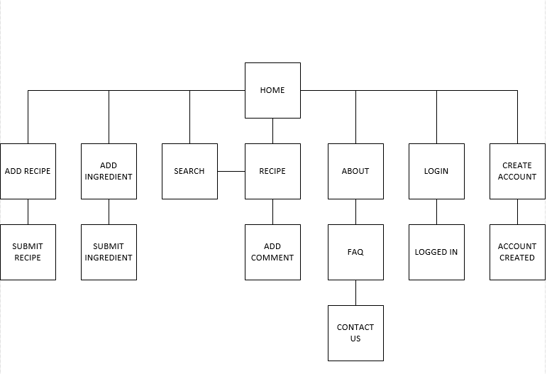
Website Layout
Notes:
Use brief bullets and discuss details verbally.

Slide 7
Database implementation
update
RECIPE T
inner join
(select R.Recipe_id, SUM(I.INGREDIENT_COST * S.INGREDIENT_AMOUNT) as Cost from RECIPE R, INGREDIENT I, STEP S where S.RECIPE_ID = R.RECIPE_ID and I.INGREDIENT_ID S.INGREDIENT_ID group by R.RECIPE_ID) k
set T.RECIPE_COST = k.Cost
where T.RECIPE_ID = k.RECIPE_ID

Slide 8
Website Demo
http://web.engr.oregonstate.edu/~skinnern/FinalCS340/Home.php

Slide 9
Questions?

